Slide 1
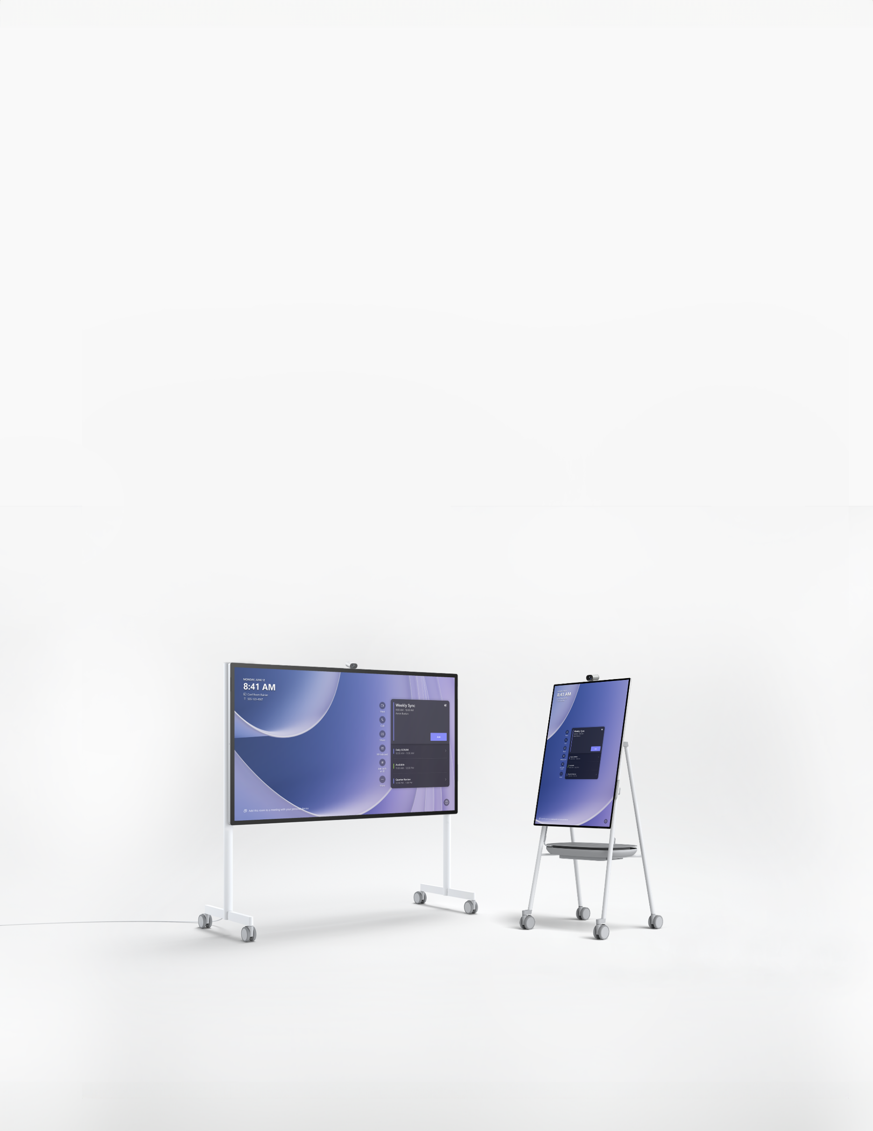
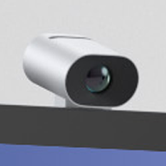
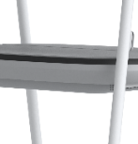
Microsoft Surface Hub 3 for Federal
Dissolve meeting boundaries and bring collaboration to life
Microsoft designed Surface Hub 3 to combine the power of a collaborative digital canvas, seamless video conferencing, and intuitive touch and pen capabilities. These features come together to enable dynamic teamwork—wherever and however your people join in. Give your employees the power to achieve more together through real-time collaboration and information sharing with support for GCC & GCC-H at launch.
THE EMPLOYEE EXPERIENCE MATTERS
MANAGE REMOTELY
STAY SECURED ANYWHERE
PUTTING YOUR MISSION FIRST
Hardware and software come together to create a seamless Microsoft Teams Room experience for every participant. Between Microsoft’s investment in human-centered design and Surface’s pioneering history of premium form factors, Surface Hub 3’s technology fades into the background so collaboration stays front and center.
Deploy with ease, manage your devices from anywhere, and maintain secured control of every
Surface Hub 3’s with Microsoft Intune, Microsoft Teams admin center, and MECM. As part of the Microsoft ecosystem, Surface Hub 3’s built-in, chip-to-cloud security¹ keeps your employees and your organization safe.
Versatile accessories and mobile stands adapt your collaborative canvas to your evolving space and technology needs. Through modular design that unlocks repairability and ongoing upgrades, Surface Hub 3 protects your investment by maximizing value throughout
its lifecycle.
Auto-framing through the AI-powered Surface Smart Camera gives participants a dynamic view of the room.
Surface Hub 3 provides the lightest device, highest resolution, and thinnest edge of any device in its category.
In-cell display technology brings a human touch to the touchscreen experience.
Images and video show up crisp and clean on the 8-bit, color-calibrated 4K HDR screen.
Screen rotation enables fluid transitions from portrait to landscape to flex the format to the task at hand.
The 8-element MEMS linear microphone array ensures everyone’s voice is crystal clear, whether they’re in person or remote.
With 4,096 pressure points, Surface Hub 3’s display delivers the most natural pen experience of any device in its class.
The APC™ Charge Mobile Battery² for Surface Hub 3 provides the power to roam.
PARTNER LOGO
Microsoft Surface Contact: Add contact info
*Screen background shown is available for download. Appearance may vary.
¹Some cloud-enabled features and functionality require paid subscription and/or qualifying license.
²APC™ Charge Mobile Battery for Surface Hub 3 50” sold separately.

Slide 2
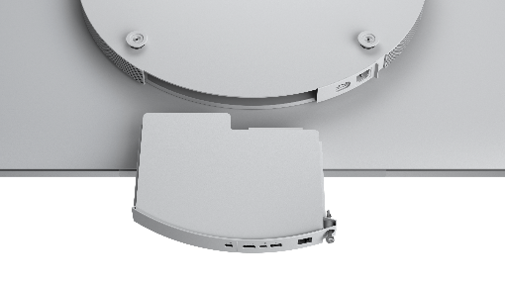
Microsoft Surface Hub 3 Pack for Surface Hub 2S
PROCESSOR
Intel i5
ACCESSIBILITY
Physical tactile feature to identify Surface Hub 3 Pack
GRAPHICS
iGPU
SERVICEABILITY³
User-replaceable components include:
Removable SSD
MEMORY AND STORAGE¹
Memory: 32 GB
Storage: 512 GB
SIZE AND WEIGHT²
Dimensions: 10.8in x 8.7in x 1.3in (275mm x 220mm x 32mm) Weight: 2.1 lbs (954gm)
EXTERIOR
Casing: Stainless steel with mineral-composite resin Color: Platinum
SECURITY
Trusted Platform Module 2.0
WHAT'S IN THE BOX
Surface Hub 3 Pack Setup Guide
PORTS
USB-A
RJ45 Gigabit Ethernet
Mini-DisplayPort Video Output* HDMI Video Input**
USB-C® with Alt-Mode DisplayPort Input**
WARRANTY⁴
1-year limited hardware warranty
*Available in Windows desktop only.
**Available in bypass only. Visit Surface Hub | Microsoft Learn to learn more about how to connect devices to Surface Hub.
SOFTWARE
Windows 11 IoT Enterprise with the Microsoft Teams Rooms on Windows experience Configurable to Windows 11 Pro/ Enterprise*
*Software license and image required. Sold separately. For additional information, visit Microsoft Learn.
Disclaimers
¹System software uses significant storage space. Available storage is subject to change based on system software updates and apps usage. 1 GB = 1 billion bytes. 1 TB = 1,000 GB. See Surface.com/Storage for more details.
²Size and weight vary by configuration and manufacturing process.
³Customer Replaceable Units (CRUs) are components available for purchase through your Surface Commercial Authorized Device Reseller. Components can be replaced on-site by a skilled technician following Microsoft’s Service Guide. Opening and/or repairing your device can present electric shock, fire and personal injury risks and other hazards. Use caution if undertaking do-it-yourself repairs. Device damage caused during repair will not be covered under Microsoft’s Hardware Warranty or protection plans. Availability of replaceable components and service options may vary by market and/or at initial product launch.
⁴Microsoft’s Limited Warranty is in addition to your consumer law rights.
PARTNER LOGO

Slide 3
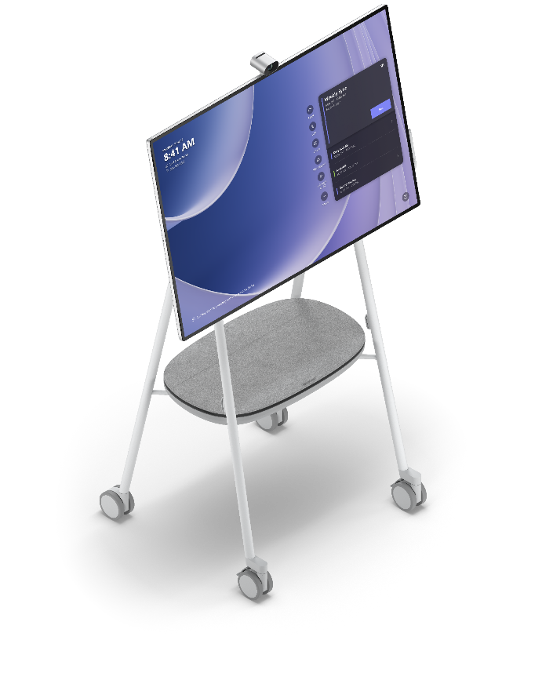
Microsoft Surface Hub 3 50"
PROCESSOR
Intel i5
AUDIO
100Hz-12KHz range front-facing 3-way stereo speakers, including
(6) front-facing mid-range, (3) front-facing tweeter and (1) rear bass drivers
2x full band 8-element MEMS microphone arrays
Smart AV optimizes audio to Portrait or Landscape
GRAPHICS
iGPU
MEMORY AND
STORAGE¹
Memory: 32 GB
Storage: 512 GB
RESOLUTION
3840 x 2560
DISPLAY
PixelSense™ Display 3:2 aspect ratio
8-bit color
15.5mm border Anti-glare, IPS LCD
In-cell Touch with 10 simultaneous touch points and two pens
PORTS
(4) USB-C including two camera ports (on display)
(1) USB-A™ (on display) RJ45 Gigabit Ethernet
Mini-DisplayPort™ Video Output* HDMI Video Input**
USB-C with Alt-Mode DisplayPort Input**
SIZE AND WEIGHT²
Height: 29.2 inch (741 mm)
Width: 43.2 inch (1097 mm)
Depth: 3.0 inch (76 mm)
Weight: 61.6 lbs (28 kg)
*Available when running Windows 10/11 Pro/Enterprise.
**Available in bypass only. Visit Surface Hub | Microsoft Learn for additional information on connecting devices to Surface Hub.
SECURITY
Trusted Platform Module 2.0
CAMERAS
Microsoft Surface Hub Smart Camera,⁵ 4K, custom USB-C® connection, 136-degree HFOV
NETWORK AND CONNECTIVITY
Wi-Fi 5: IEEE 802.11ac (a/b/g/n/ac compatible)
Bluetooth® Wireless 5.1 technology
Gigabit Ethernet Microsoft Teams Cast*
*For additional information on casting content to Microsoft Teams Rooms, visit Microsoft Support.
PEN AND ACCESSORIES
COMPATIBILITY
Active, dual-pen inking support Microsoft Surface Hub Pen⁶ (active)
Microsoft Surface Slim Pen, Microsoft Surface Slim Pen 2 Compatible with Microsoft Teams Rooms certified peripherals
Disclaimers
¹System software uses significant storage space. Available storage is subject to change based on system software updates and apps usage. 1 GB = 1 billion bytes. 1 TB = 1,000 GB. See Surface.com/Storage for more details.
²Size and weight vary by configuration and manufacturing process.
⁵Formerly known as the Surface Hub 2 Smart Camera.
⁶Formerly known as the Surface Hub 2 Pen.
PARTNER LOGO

Slide 4
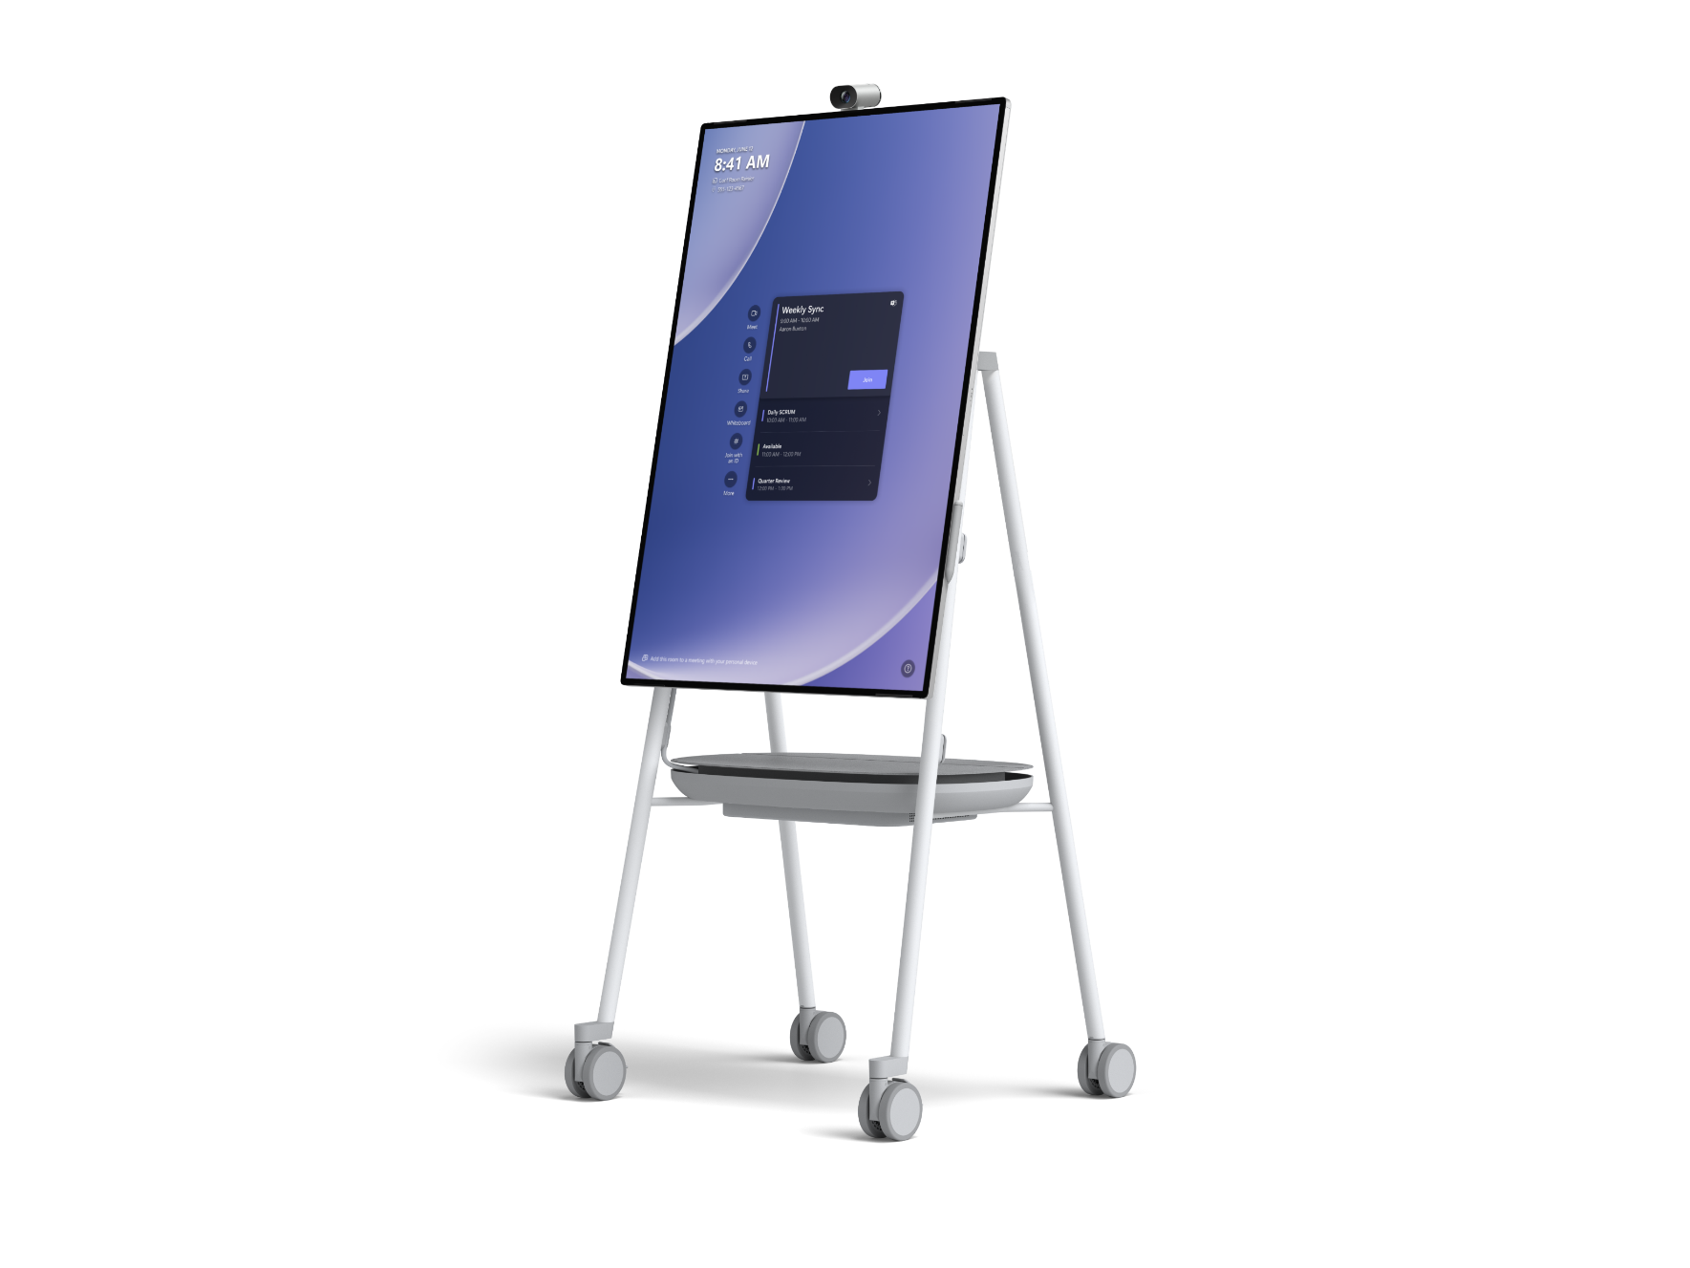
Microsoft Surface Hub 3 50"
SOFTWARE
Windows 11 IoT Enterprise with the Microsoft Teams Rooms on Windows experience Configurable to Windows 11 Pro/ Enterprise*
SENSORS
Doppler occupancy sensor Accelerometer
Gyroscope
WHAT'S IN THE BOX
(1) Surface Hub 3 50”
(1) Surface Hub Smart Camera⁵
(1) Surface Hub Pen⁶ 3m AC Power Cable Quick Start Guide
*Software license and image required. Sold separately. For additional information, visit Microsoft Learn.
ACCESSIBILITY
Compatible with height-adjustable, mobile stands*
Includes Teams Accessibility Features – Learn More Accessibility Features | Microsoft Accessibility Discover More Microsoft Accessible Devices & Products – Accessible Devices & Products for PC & Gaming | Assistive Tech Accessories – Microsoft Store
WARRANTY⁴
1-year limited hardware warranty
*Sold separately.
SERVICEABILITY³
User-replaceable components include:
Modular compute cartridge with removable SSD
Surface Hub Smart Camera⁵ Surface Hub Pens⁶
EXTERIOR
Casing: Precision machined aluminum with mineral-composite resin
Color: Platinum
Physical Buttons: Power, Volume, Source
Disclaimers
³Customer Replaceable Units (CRUs) are components available for purchase through your Surface Commercial Authorized Device Reseller. Components can be replaced on-site by a skilled technician following Microsoft’s Service Guide. Opening and/or repairing your device can present electric shock, fire and personal injury risks and other hazards. Use caution if undertaking do-it-yourself repairs. Device damage caused during repair will not be covered under Microsoft’s Hardware Warranty or protection plans. Availability of replaceable components and service options may vary by market and/or at initial product launch.
⁴Microsoft’s Limited Warranty is in addition to your consumer law rights.
⁵Formerly known as the Surface Hub 2 Smart Camera.
⁶Formerly known as the Surface Hub 2 Pen.
PARTNER LOGO

Slide 5
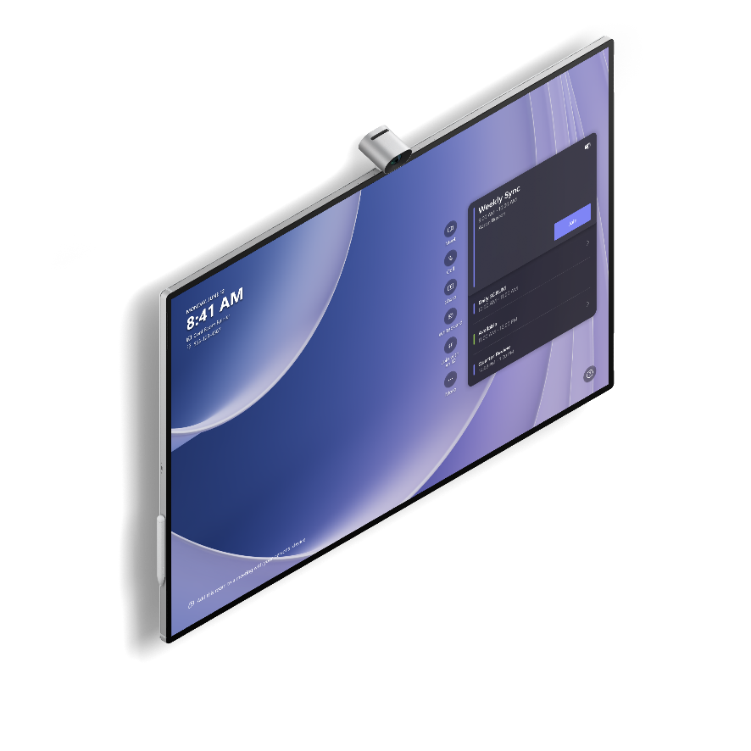
Microsoft Surface Hub 3 85"
PROCESSOR
Intel i5
AUDIO
100Hz-12KHz range 3-way stereo speakers, including (4) front-facing mid-range, (2) front-facing tweeter and (1) rear bass drivers
Full band 8-element MEMS microphone array
GRAPHICS
iGPU
MEMORY AND
STORAGE¹
Memory: 32 GB
Storage: 512 GB
RESOLUTION
3840 x 2160
PORTS
(3) USB-C (on display)
(1) USB-A™ (on display) RJ45 Gigabit Ethernet
Mini-DisplayPort™ Video Output* HDMI Video Input**
USB-C with Alt-Mode DisplayPort Input**
DISPLAY
PixelSense™ Display 16:9 aspect ratio
8-bit color 30.5mm border Anti-glare, IPS LCD
In-cell Touch with 20 simultaneous touch points and two pens
*Available when running Windows 10/11 Pro/Enterprise.
**Available in bypass only. Visit Surface Hub | Microsoft Learn for additional information on connecting devices to Surface Hub.
SIZE AND WEIGHT²
Height: 44.5 inch (1130 mm)
Width: 77.1 inch (1959 mm)
Depth: 3.4 inch (85.6 mm)
Weight: 185 lbs (84 kg)
SECURITY
Trusted Platform Module 2.0
NETWORK AND CONNECTIVITY
Wi-Fi 5: IEEE 802.11ac (a/b/g/n/ac compatible)
Bluetooth® Wireless 5.1 technology
Gigabit Ethernet Microsoft Teams Cast*
CAMERAS
Microsoft Surface Hub Smart Camera,⁵ 4K, custom USB-C® connection, 136-degree HFOV
*For additional information on casting content to Microsoft Teams Rooms, visit Microsoft Support.
PEN AND ACCESSORIES
COMPATIBILITY
Active, dual-pen inking support Microsoft Surface Hub Pen⁶ (active)
Microsoft Surface Slim Pen, Microsoft Surface Slim Pen 2 Compatible with Microsoft Teams Rooms certified peripherals
Disclaimers
¹System software uses significant storage space. Available storage is subject to change based on system software updates and apps usage. 1 GB = 1 billion bytes. 1 TB = 1,000 GB. See Surface.com/Storage for more details.
²Size and weight vary by configuration and manufacturing process.
⁵Formerly known as the Surface Hub 2 Smart Camera.
⁶Formerly known as the Surface Hub 2 Pen.
PARTNER LOGO

Slide 6
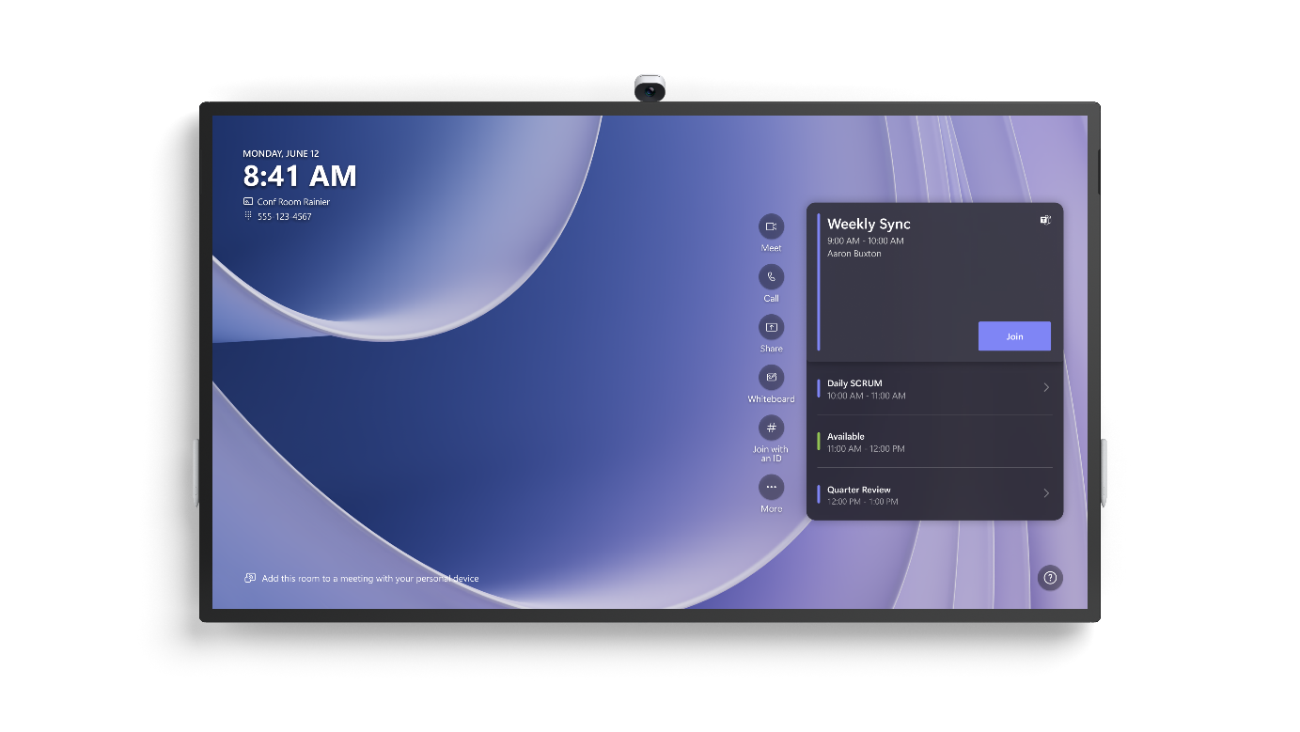
Microsoft Surface Hub 3 85"
SOFTWARE
Windows 11 IoT Enterprise with the Microsoft Teams Rooms on Windows experience Configurable to Windows 11 Pro/ Enterprise*
SERVICEABILITY³
User-replaceable components include:
Modular compute cartridge with removable SSD
Surface Hub Smart Camera⁵ Surface Hub Pens⁶
*Software license and image required. Sold separately. For additional information, visit Microsoft Learn.
EXTERIOR
Casing: Precision machined aluminum with mineral-composite resin
Color: Platinum
Physical Buttons: Power, Volume, Source
ACCESSIBILITY
Compatible with height-adjustable, mobile stands*
Includes Teams Accessibility Features – Learn More Accessibility Features | Microsoft Accessibility Discover more Microsoft Accessible Devices & Products
- Accessible Devices & Products for PC & Gaming | Assistive Tech Accessories - Microsoft Store
SENSORS
Doppler occupancy sensor
WHAT'S IN THE BOX
(1) Surface Hub 3 85”
(1) Surface Hub Smart Camera⁵
(2) Surface Hub Pen⁶ 4m AC Power Cable Quick Start Guide
*Sold separately.
WARRANTY⁴
1-year limited hardware warranty
Disclaimers
³Customer Replaceable Units (CRUs) are components available for purchase through your Surface Commercial Authorized Device Reseller. Components can be replaced on-site by a skilled technician following Microsoft’s Service Guide. Opening and/or repairing your device can present electric shock, fire and personal injury risks and other hazards. Use caution if undertaking do-it-yourself repairs. Device damage caused during repair will not be covered under Microsoft’s Hardware Warranty or protection plans. Availability of replaceable components and service options may vary by market and/or at initial product launch.
⁴Microsoft’s Limited Warranty is in addition to your consumer law rights.
⁵Formerly known as the Surface Hub 2 Smart Camera.
⁶Formerly known as the Surface Hub 2 Pen.
PARTNER LOGO

Slide 7
Accessories
Microsoft Surface Hub Smart Camera⁵
DIMENSIONS
43mm high (54.6mm high with foot) x 67mm wide x 66mm deep (42mm wide foot)
CONNECTIONS
Mounting: Top of Surface Hub 2S and Surface Hub 3 50” and 85” Mechanical & Electrical Interface to Hub: USB-C break-away magnetic attach to top of bezel Interface to Surface Hub 2S, Surface Hub 3 50” and 85”: Customized USB-C
Reversible USB-C connection: Not supported.
MEMORY
1 GB DRAM, 8 GB eMMC (Not user accessible)
PROCESSOR
Intel Myriad X 2085 (Image Signal Processor and NN SOC with 1 TFLOPS of DNN acceleration and 18 cores)
CAMERA AND VIDEO FEATURES
Fixed focus lens with 11 glass elements
1 RGB Camera Module Working Distances: 1.0 – 7.4m HFOV: >136 degrees
Tilt range: +20deg and -20deg from horizontal. Surface Hub Smart Camera⁴ adapts its de-warp mesh to un-distort the image according to the camera tilt angle, so the image always looks natural. Video Format: 16:9 (NV12 at 360p, 720p, 1080p, 1440p)
Privacy cover magnetically attaches to front of camera for privacy, and magnetically attaches to back of camera for convenient storage
SECURITY
Camera software is updatable through Windows Update via Hub Software updates protected by signature security process
SOFTWARE
Intelligent functionality: IntelliFrame support on Microsoft Teams Rooms*
Automatic framing** (automatically frames people in field of view)
Image optimization (auto exposure, auto white balance, anti-flicker)
Tilt angle adapting de-warp/un- distortion for natural faces across the field of view
Upgradability:
Internal Camera firmware can be updated with new functionality or bug fixes through Windows Update
EXTERIOR
Casing: Anodized Aluminum Color: Platinum
Physical buttons: None One white LED indicator for
camera status (indicator is only visible when ‘On’)
*Software license required. Sold separately.
**Available when running Windows 10 Team Edition or Windows 10/11 Pro/Enterprise.
WARRANTY⁴
1-year limited hardware warranty (All Countries)
WHAT'S IN THE BOX
Microsoft Surface Hub Smart Camera⁵ with privacy cover Quick Start Guide
Safety and warranty documents
SENSORS
Sensor Resolution: 12MP
WEIGHT²
180g with privacy cover
Disclaimers
²Size and weight vary by configuration and manufacturing process.
⁴Microsoft’s Limited Warranty is in addition to your consumer law rights.
⁵Formerly known as the Surface Hub 2 Smart Camera
PARTNER LOGO

Slide 8
Accessories
Microsoft Surface Hub Pen⁶
DIMENSIONS
5.94" x 0.64" x 0.56" (151 mm x
16.3 mm x 14.3 mm)
WEIGHT²
0.09 lb (41g)
BUTTONS
Barrel button and tail eraser
COLOR
Grey
CONNECTOR
TYPE
Bluetooth 4.0
COMPATIBILITY
Surface Hub 3 50” and 85” Surface Hub 2S*
*Also compatible with select Surface devices.
Visit Microsoft Support for additional information.
Disclaimers
²Size and weight vary by configuration and manufacturing process.
⁶Formerly known as the Surface Hub 2 Pen.
PARTNER LOGO

Slide 9
Microsoft Surface Hub 3 Part Numbers
SURFACE HUB 3 50” TAA
VXZ-00001
SURFACE HUB 3 85” TAA
VYB-00001
SURFACE HUB 3 PACK TAA
VXS-00001
SURFACE HUB SMART CAMERA
2IN-00001
SURFACE HUB PEN
LPN-00001
PARTNER LOGO

